Slide 1
SIT UP STRAIGHT!
Posture Correction with Arduino
Sanjana Kamath
Deepika Punyamurtula

Slide 2
Motivation
Poor Posture - A very problem faced by all
Very little help for this in the market. Very product like LUMOBACK
Can relate to it personally
Posture correction can be developed using arduino and flex sensor

Slide 3
What we did?
Wearable posture corrector which beeps when it detects an incorrect posture
Used Arduino Uno, Flex sensor and other external modules
Android application to help the data realize his data
AChartEngine graph library to visualize the data

Slide 4
Building Blocks [1/2]
Hardware
Arduino Uno Rev 3
SD card Shield
Peizo Buzzer Element
Flex Sensor 4.5’’
RTC Clock Module
Alkaline 9V Battery

Slide 5
Building Blocks [2/2]
Software
Arduino Libraries
DS1307RTC Library , SD card Library, Time Library ,Wire I2C Library
AChartEngine - Android Charting Library
Line Graph, Dial Graph, Bar Graph
SQLite Database

Slide 6
All about Data [1/1]
What data did we collect?
Collected the following data in CSV format over a period of ~7 days
Time
Date
Angle of Back Bend
Beep
How did we manage the collected data?
2. Created a SQLite database for the above data

Slide 7
Visualizations
Plotted graphs using AChartEngine to visualize the same.
Bar Chart - To plot the number of beeps per day
Line Graph - To view continuous readings of the flex angle over time
Posture Score - Give the user a posture score out of 100

Slide 8
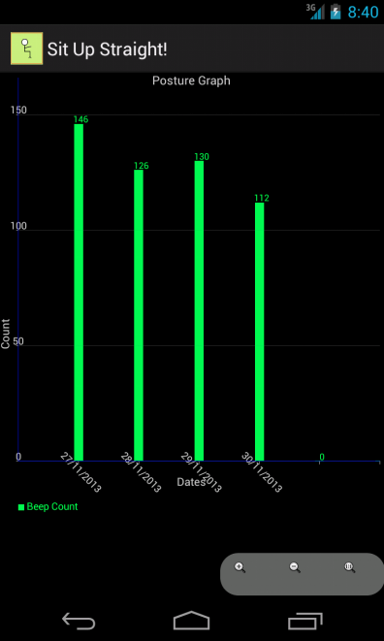
Bar Graph - Beep counts
Date Major Activity
27/11/2013 Watching TV on a couch
28/11/2013 Reading a book
29/11/2013 Using a Laptop
30/11/2013 Reading - (This time no. of readings reduced!!)

Slide 9
User Activity log During Data Collection
Date Major Activity
27/11/2013 Watching TV on a couch
28/11/2013 Reading a book
29/11/2013 Using a Laptop
30/11/2013 Reading - (This time no. of readings reduced!!)

Slide 10
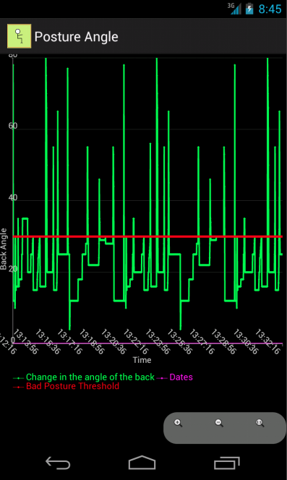
Line Graph - Sensor Data

Slide 11
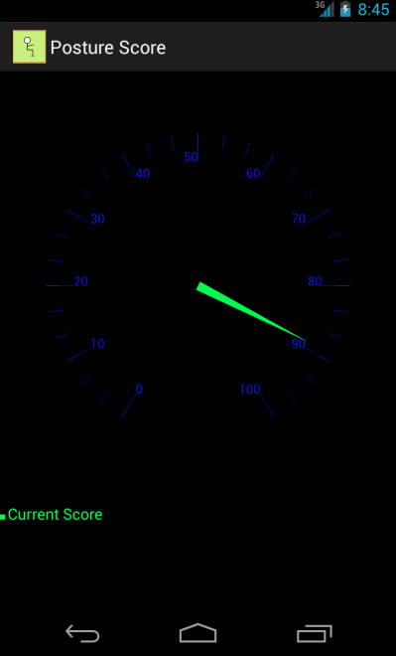
Posture Score

Slide 12
What we learned
Extracted interesting data
Reduced beep counts over time
Faced issues with the RTC module
Creating a wearable device is interetsting and challenging
Arduinos and sensor are fun to work with
Used SQLLite Database to store data
AChartEngine has many limitations compared to other dekstop processing tools

Slide 13
Q & A

